Slide 1

Team Name: WUNDERKINDS
Problem Statement: Open Innovation

Slide 2

TABLE OF CONTENTS
ABSTRACT | Describe your idea/solution/prototype.
TECHNICAL APPROACH | Technology and methodology to be used (e.g. language, framework, hardware and flow charts/working prototype).
FEASIBILITY & VIABILITY | Analysis of the feasibility, potential challenges and risk.
IMPACT & BENEFITS | Social, economic, environmental benefits and impact.
FUTURE SCOPE & NEXT STEP | Scalability, Long-Term Vision, Monetization/Adoption Strategy
OUR TEAM | All team members name, registration no. and mail.

Slide 3
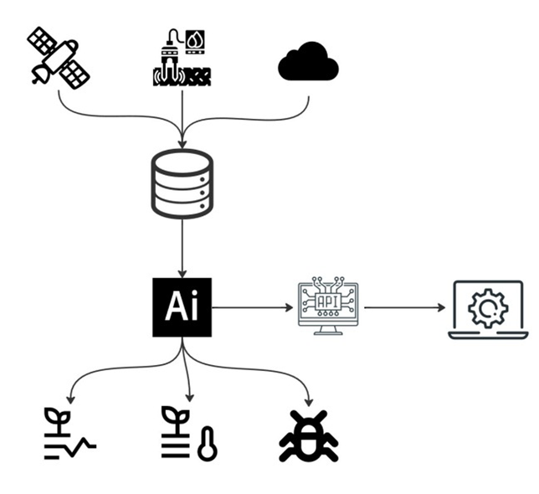
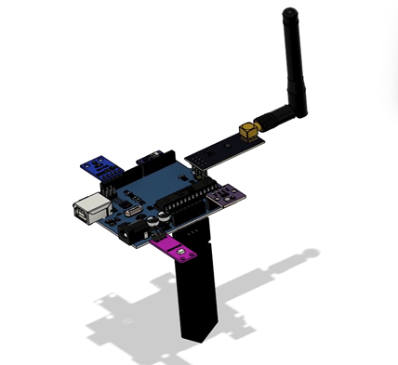
ABSTRACT
We are developing an AI-powered software platform for crop health monitoring designed for farmers and agronomists. Our solution integrates freely available satellite multispectral imagery with data from low-cost ground sensors and weather forecasts.
Using a combination of AI models, including Swin-UNet for spatial analysis and LSTM for time-series prediction, the platform predicts future vegetation stress and pest outbreak risks.
This information is delivered through an interactive dashboard and mobile alerts with a user-friendly, traffic-light system to make data-driven precision agriculture accessible, scalable, and low-cost.
3D Model of Module

Slide 4
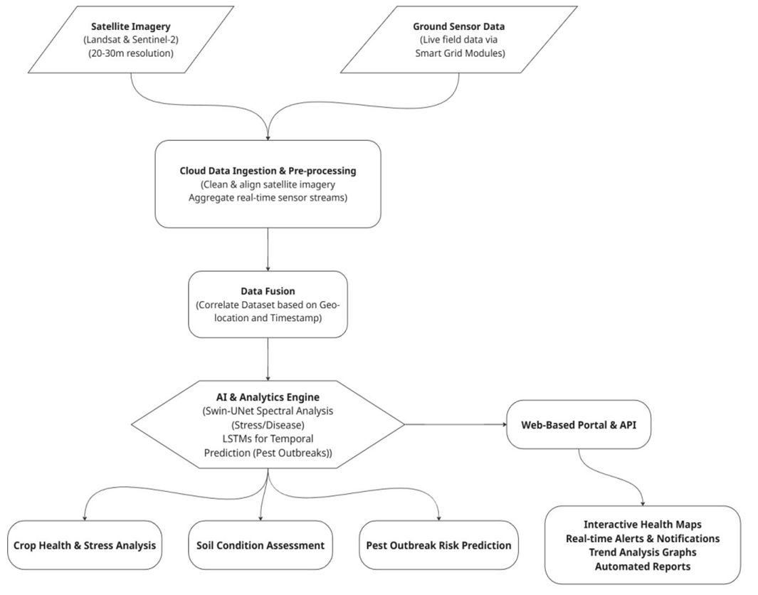
TECHNICAL APPROACH
Frontend: Javascript + React.js
Backend: Supabase Client, Esp-32 based ground station
Database: Supabase
ML Models: LSTM.
Hardware: Low-power microcontroller with plant profile sensors.

Slide 5
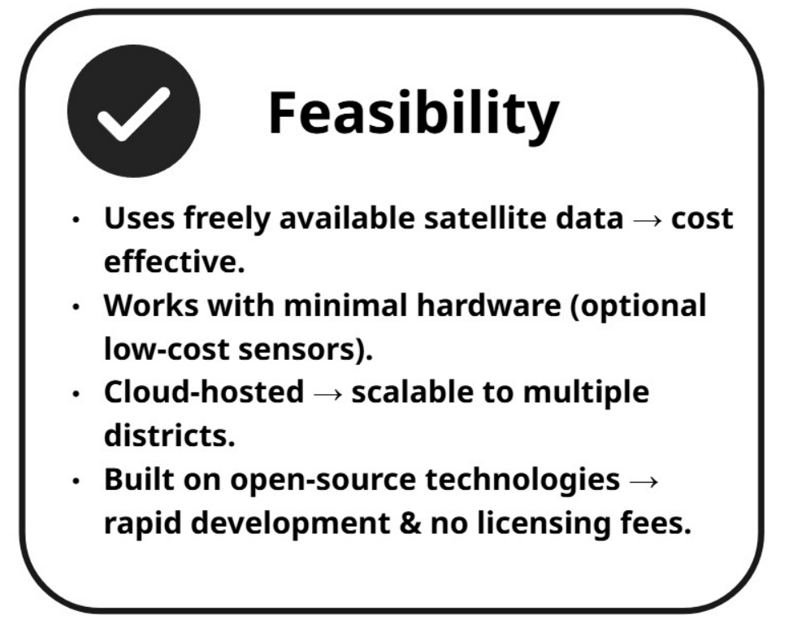
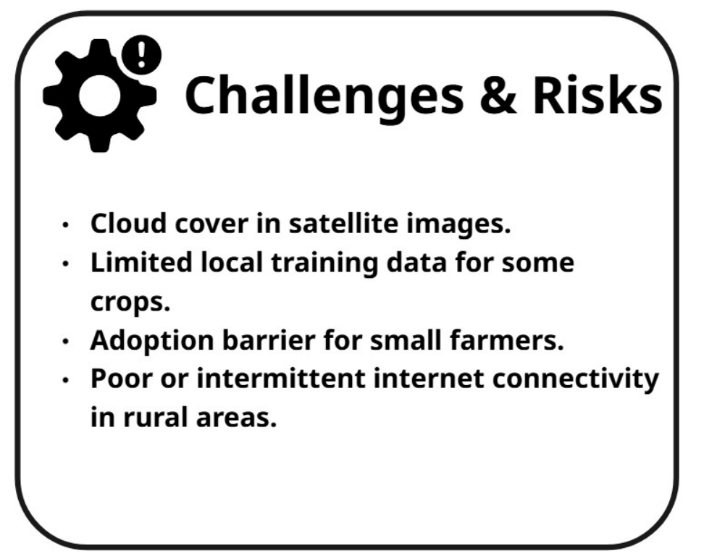
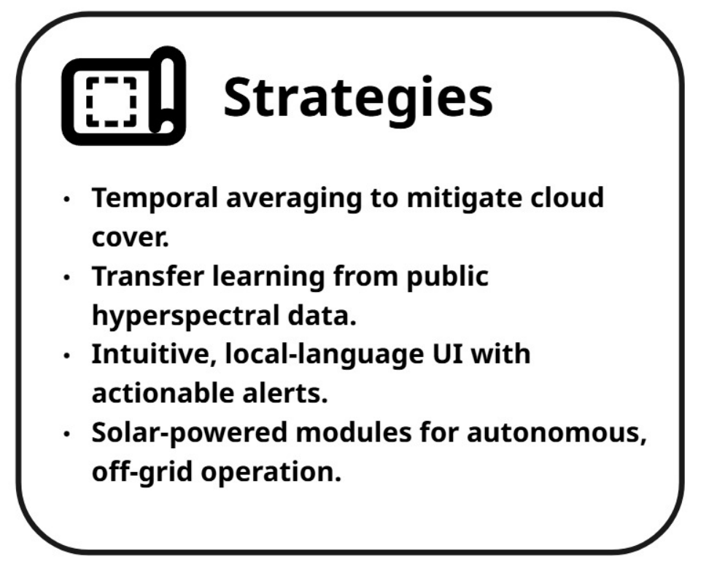
FEASIBILITY AND VIABILITY

Slide 6
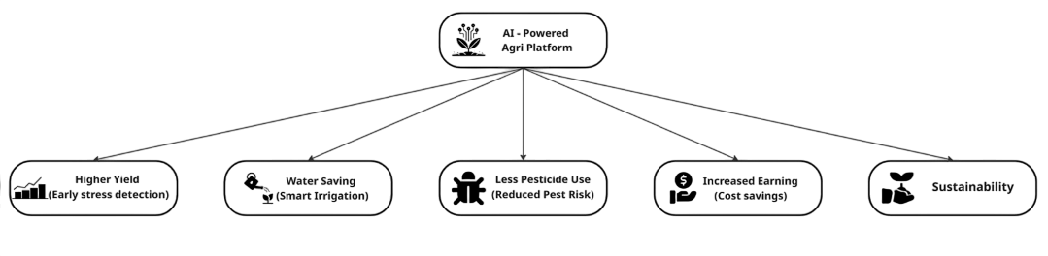
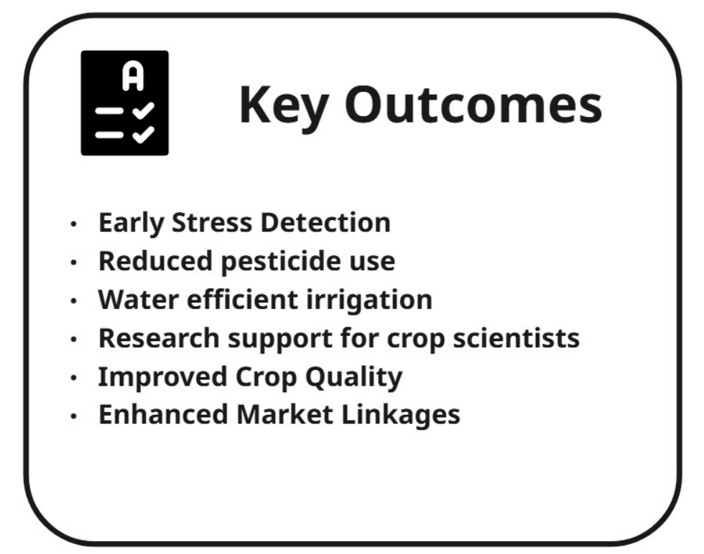
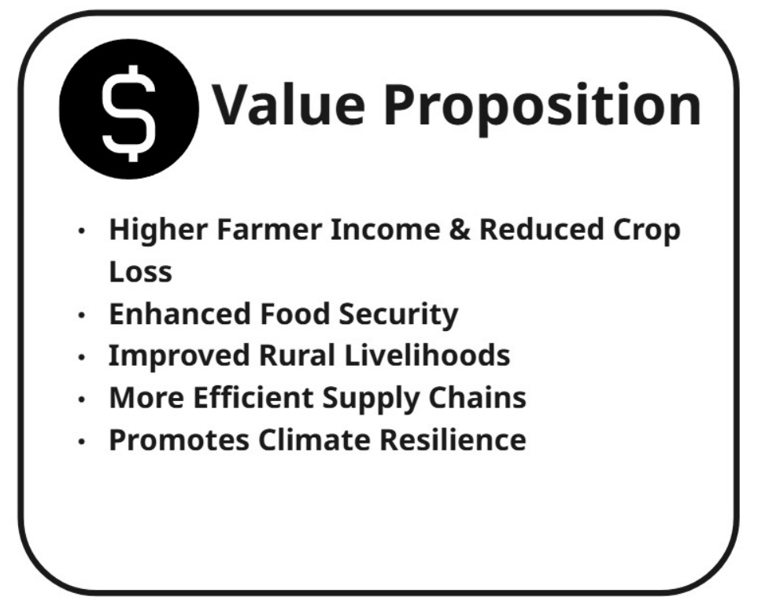
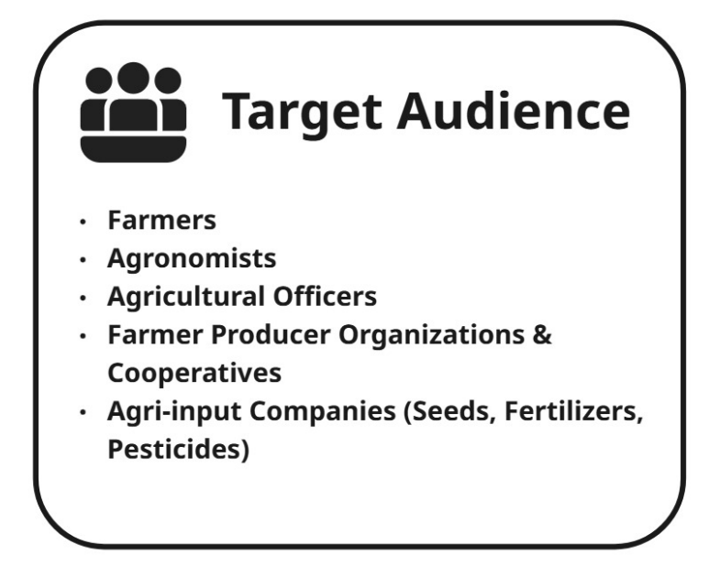
IMPACT & BENEFITS

Slide 7
FUTURE SCOPE & NEXT STEP
Scalability: Expand to nationwide → global, add drones + advanced IoT sensors.
Vision: All-in-one Digital Agronomy Assistant (soil, yield, irrigation, pest).
Adoption: TIE UPS WITH KVK’S AND AGRONOMISTS
Next Steps: Pilot testing → data collection → model tuning → funding/incubation.

Slide 8

OUR TEAM
Member 1: Aaditya Chaturvedy (Team Lead) Reg.No: RA2411003010305 Email: aadityachaturvedy@gmail.com
Member 2: Anusheel Singh Reg.No: RA2411004010351 Email: anusheelsingh04@gmail.com
Member 3: Arnav Bharadwaj Reg.No: RA2411003010347 Email: bharadwaj.arnav08@gmail.com
Member 4: Rishab Sanghai Reg.No: RA2411003010293 Email: rs8264@srmist.edu.in

